Slide 1

Department of Electrical Engineering (Gyan Ganga Institute of Technology & Sciences, Jabalpur) (NBA Accredited Program) Approved by AICTE, New Delhi Affiliated to RGPV, Bhopal Welcomes All Delegates of Tata Consultancy Services (TCS)

Slide 2
Programme: UG in Electrical Engineering
YEAR OF STARTING OF THE UG PROGRAMME: In 2003 with sanctioned intake of 60 students.
In addition to U.G Elect. Engg. Course, Department also runs,
M.Tech: Full Time Degree Course in ENERGY TECHNOLOGY(2009)
M.Tech: Part Time Degree course in PS&A (2013)

Slide 3
Vision
To produce Electrical Engineering graduates with sound technical knowledge and with ethical values who could excel in Electrical Systems.
To apprise students of state of art technology and industrial engineering applications.
To make Electrical Department as a centre of excellence.
To encourage industrial activities in department with faculty and student participation.

Slide 4
Mission
To Impart intensive and innovative teaching and training through latest technology to provide cutting edge for achieving excellence.
To award practical projects aiming at solutions to practical industrial problems.
To motivate faculty and technical assistants for updating / upgrading knowledge through training, seminars, workshops, conferences and higher studies.
To create accredited / certified centre for testing of transformers and other electrical equipments to cater to the needs of power sector / industries.
Impart knowledge / solutions of social challenges, ethics, echo / environment etc. to produce worthy citizens.

Slide 5
Programme Educational Objectives
Graduates will enter careers in the MNCs, PSUs Private sector companies, etc. in the field of design, application, installation, manufacturing, operation & maintenance of electrical systems.
Graduates will be undertaking higher studies. Graduate will analyze real life problems, will design techno-commercially feasible solutions to social problems.
Graduates will be entrepreneurs, and will produce intellectual citizen to constitute an elegant society to meet social challenges with ethical & moral values having concern for the echo and environment.

Slide 6
Admission / Intake in the Programme
Name of the Programme : UG in Electrical Engineering
Title of the Degree : Bachelor of Engineering in Electrical Engineering
Nature of Programme :Full time
Duration :Four Years
Sanctioned Intake :60+TFW + (20% Lateral Entry in BE II Year )

Slide 7
Admission / Intake in the Programme
Name of the Programme : PG in ENERGY TECHNOLOGY
Title of the Degree : M.TECH. IN ENERGY TECHNOLOGY
Nature of Programme :Full time
Duration :02 Years
Sanctioned Intake :18

Slide 8
Admission / Intake in the Programme
Name of the Programme : PG in POWER SYSTEM & AUTOMATION
Title of the Degree : M.TECH. IN POWER SYSTEM & AUTOMATION
Nature of Programme :PART TIME
Duration :03 Years
Sanctioned Intake :18

Slide 9
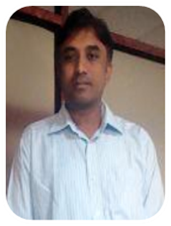
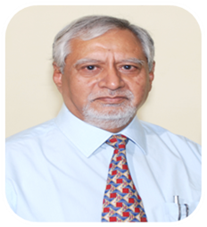
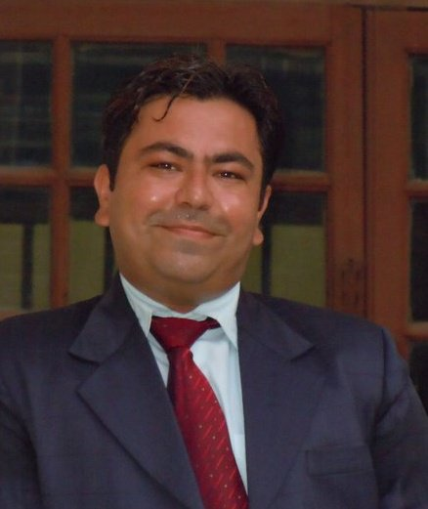
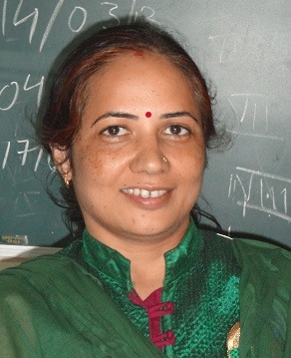
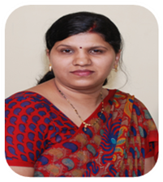
FACULTY MEMBERS
Prof. S. K. BAJPAI
Designation : Professor
Qualification/Specialization :
M.E .(Applied Electronics)
SGSITS, Indore
E. A. BEE (GOI)
Experience : 36 Years(Industrial)
07 Years (Teaching)
Prof. RAJEEV CHAUHAN
Designation : Head of Department
Qualification /Specialization :
M.Tech., Ph.D.
(Pursuing ,BIT, Mesra -Power System )
Experience : 14 Years (Teaching)
03 Years (Industrial)
Prof. VIVEK ANAND
Designation : Prof
Qualification/Specialization :
M.E. (Digital Communication)
M.Tech (Measurement & Instrumentation) - IIT Roorkee
Experience : 15 Years (Teaching)
Prof. NIDHI MISHRA
Designation : Asst. Professor
Qualification/Specialization :
M.E. (High Voltage & Power System)
JEC, Jabalpur
Experience : 22 Years (Teaching)
Prof. SHALINI VAISHYA
Designation : Asst. Professor
Qualification/Specialization :
M.E. (Embedded System)
SGSITS, Indore
Experience : 16 Years (Teaching)

Slide 10
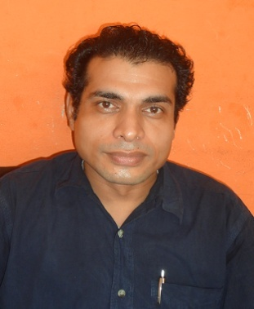
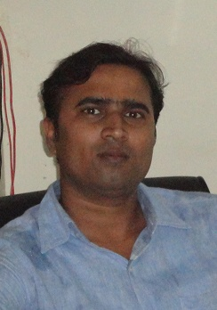
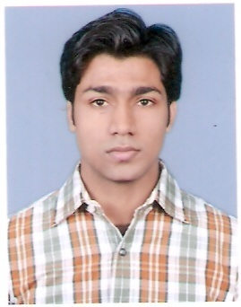
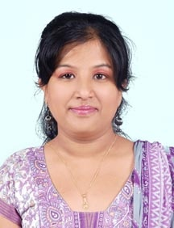
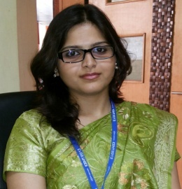
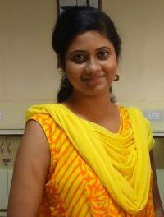
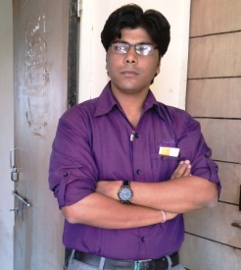
FACULTY MEMBERS
Prof. S. K. JAIN
Designation : Asst. Professor
Qualification/Specialization :
M. E. (Communication System)
JEC, Jabalpur
Experience : 10 Years (Teaching)
01 Year (Industrial)
Prof. VIVEK KUSHWAHA
Designation : Asst. Professor
Qualification/Specialization :
M. E. (Control System)
JEC, Jabalpur
(Pursuing PHD,BIT, Mesra- Control System )
Experience : 10 Years (Teaching)
Prof. RAGHUWANSH SINGH
Designation : Asst. Professor
Qualification/Specialization :
M. E. (Control System)
Experience : 2 Years (Teaching)
Prof. POONAM SARAWGI
Designation : Asst. Professor
Qualification/Specialization :
M. Tech (Energy Technology)
GGITS, Jabalpur
Experience : 6 Years (Teaching)
Prof. SHUBHANGI RAJMISTRY
Designation : Asst. Professor
Qualification/Specialization :
M. E. (Control System)
JEC, Jabalpur
Experience : 2.5 Years (Teaching)
Prof. ABHISHEK GUPTA
Designation : Asst. Professor
Qualification/Specialization :
M. Tech (Optoelectronics)
SGSITS, Indore
Experience : 4 Years (Teaching)
Prof. RUMA DEB
Designation : Asst. Professor
Qualification/Specialization :
M. Tech (VLSI)
Satyabhama University, Chennai
Experience : 02 Years (Teaching)

Slide 11
ACADEMIC ACHIEVEMENTS RESULTS -FINAL YEAR
ACADEMIC SESSION | VIII SEMESTER
Batch 2013 -2017 | 100%
Batch 2012 -2016 | 96.56%
Batch 2011 -2015 | 100.00%
Batch 2010 -2014 | 100.00%

Slide 12
Chancellor’s Awards
This award is given by The Hon'ble Governor of M.P who is the chancellor of all the state Universities.
In this award a cash Prize of 25000/- along with the certificate is given to the best 3 students who are the outstanding performers in the theory subjects of a semester in every programme in entire University.
EE Department has excellent track record of this award.

Slide 13
Chancellor’s Awards in University Examination
Year of Passing | Name of the Student | Branch | University Rank in whole M.P.
2009 | Mr. Akshay Chouksey | EE | 1st Rank (I Sem.)
2010 | Ms. Sakshi Vishnoi | EE | 2nd Rank (IV Sem.)
 | Ms. Sameeksha Baghel | EE | 1st Rank (IV Sem.)
2012 | Ms. Sweta Yadav | EE | 1st Rank (IV Sem.)
2014 | Ms. Anushree Saini | EE | 1st Rank (III Sem.)
 | Ms. Deepti Choubey | EE | 1st Rank ( I Sem.)
 | Ms. Darshika khanna | EE | 1st Rank ( I Sem.)
 | Mr. Chandraditya Jha | EE | 1st Rank ( I Sem.)

Slide 14
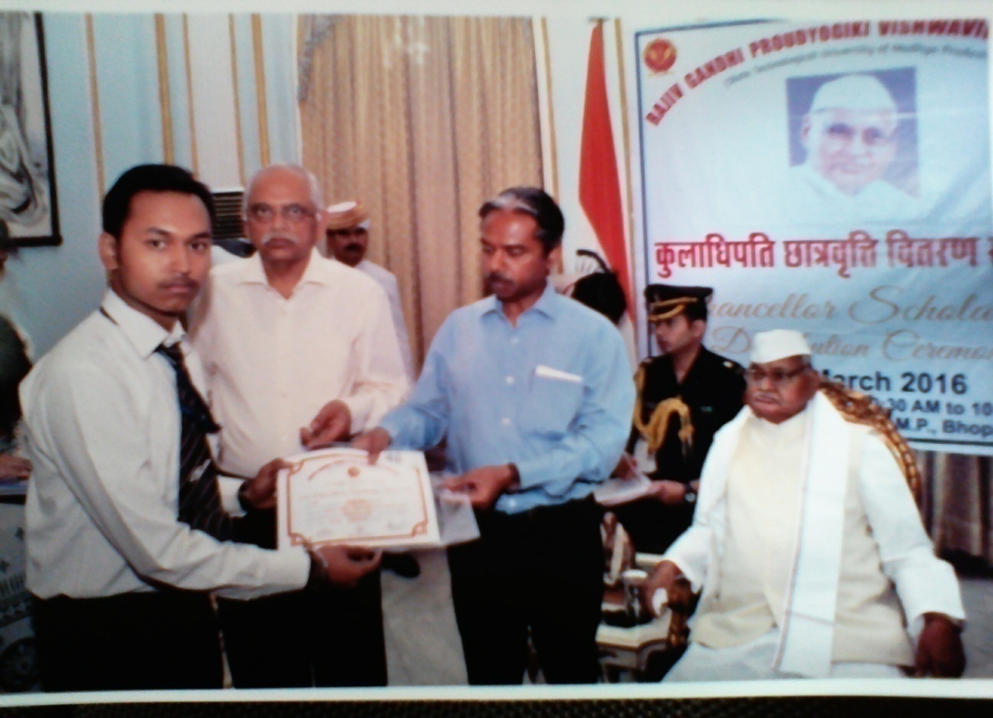
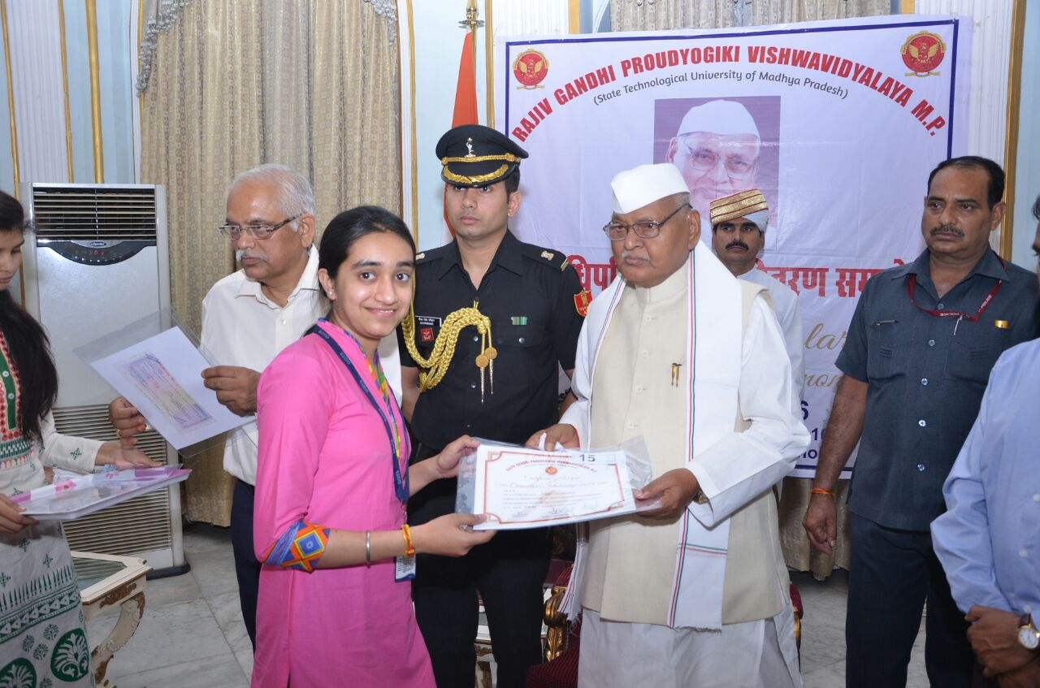
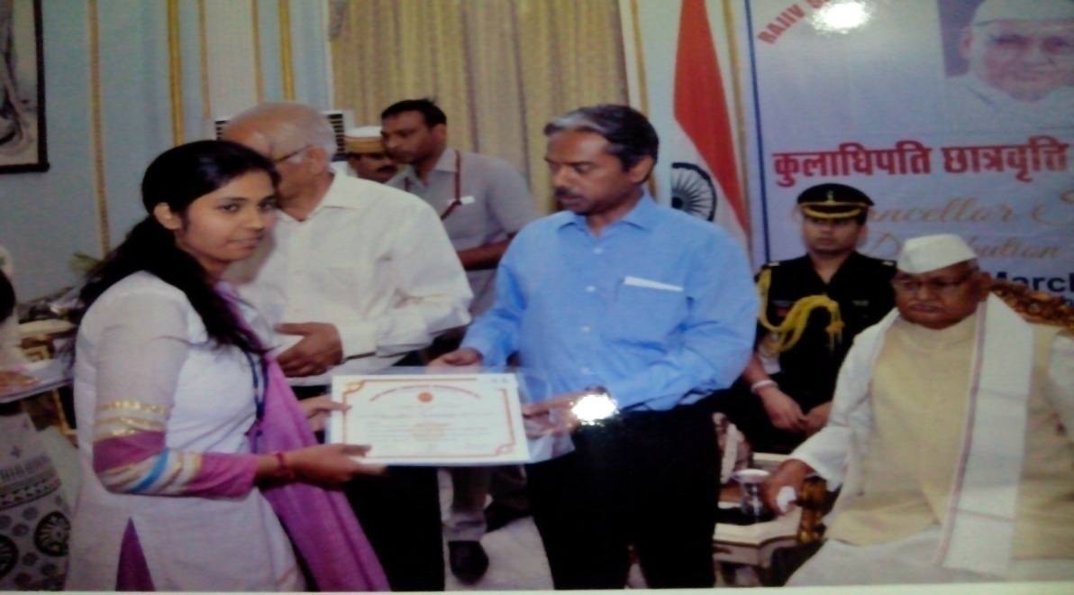
Chancellor’s Awards

Slide 15
UNIVERSITY TOPPERS IN U.G
Ms. Shrasti Jain student of Electrical Engg. Dept. scored 9.7 SGPA, in IV Semester in university examination, highest in M.P. Region.
Ms. Vaishnavi Chouksey of Electrical Engg. Dept. scored 9.77 SGPA, in II Semester in university examination, highest in M.P. Region.

Slide 16
PERFORMANCE IN GATE, MBA/CAT, GRE (HIGHER STUDIES )
Year | Nature of Exam | No. of Student qualified
2015 | GATE | 05
 | GRE | 01
 | MBA/CAT | 06
2016 | GATE | 05
 | GRE | -
 | MBA/CAT | 05
2017 | GATE | 04
 | GRE | -
 | MBA/CAT | 04

Slide 17
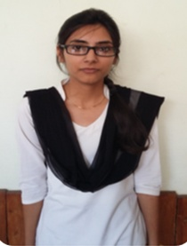
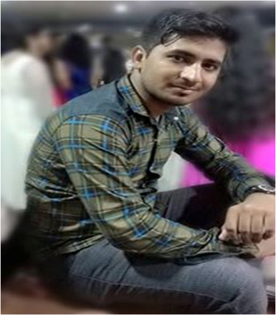
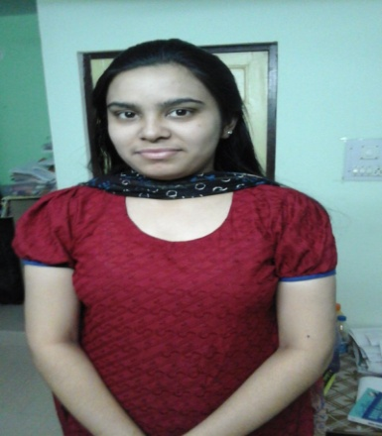
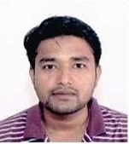
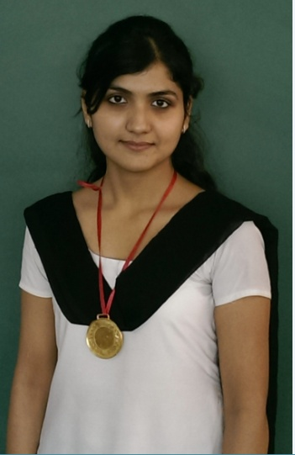
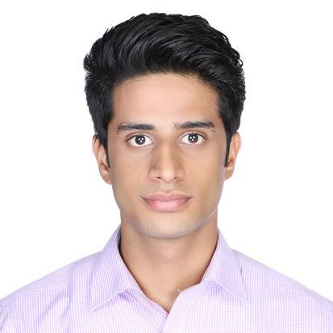
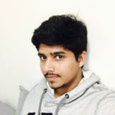
PERFORMANCE IN GATE, MBA/CAT, GRE (HIGHER STUDIES )
TOPPER’S AND GATE QUALIFIED (BATCH: 2017, 2016)
Work at Robert Bosch LLC - Research and Technology Center.
Analyst, Mobile App Integration · Palo Alto, California
Education
School of Information Studies at Syracuse University
Information Management · Syracuse, New York
GRE Score :-324 (2015)
University of Illinois , Urbana Champaign USA
(World Ranking Top 21 University-2015)
Specialization Technology Management
GRE QUALIFIED

Slide 18
PLACEMENT & HIGHER STUDIES DETAILS OF EE DEPT
Year | PLACEMENT & HIGHER STUDIES | No. of Student
2015 | ON CAMPUS | 21
 | OFF CAMPUS | 24
 | HIGHER STUDIES | 09
2016 | ON CAMPUS | 33
 | OFF CAMPUS | 37
 | HIGHER STUDIES | 06
2017 | ON CAMPUS | 25
 | OFF CAMPUS | 15
 | HIGHER STUDIES | 07

Slide 19
STUDENTS PLACEMENTS IN COMPANIES
SR. NO. | NAME OF THE COMPANIES
1 | TCS
2 | TECH. MAHINDRA
3 | HINDUJA GROPU
4 | MPHASIS
5 | PRISM CEMENT
6 | KEC INTERNATIONAL LTD.
7 | EURASIAN MINERALS (P) LTD.
8 | SOFCON INDIA (P) LTD.
9 | SHRIRAM TRANSPORT FINANCE CO
10 | EPIC RESEARCH (P) LTD.
11 | J K TECHNOSOFT
12 | ZEBRONICS
13 | UNIVARSAL CABLES
14 | ORIENT PAPERS MILLS
15 | SIEMENS PVT. LTD.
16 | VIJAY ELECTRICALS
17 | CROMPTON GREAVES
18 | SUVIDHA ENGINEERS INDIA PVT., LTD
19 | ESSAR POWERS & Many More

Slide 20
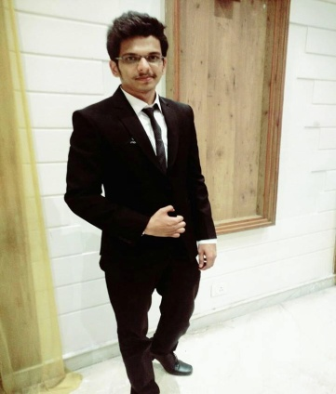
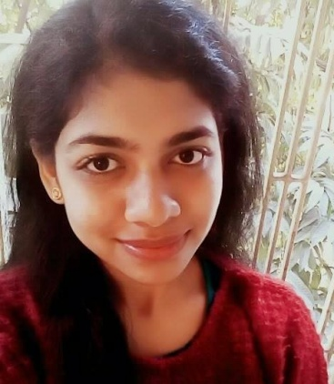
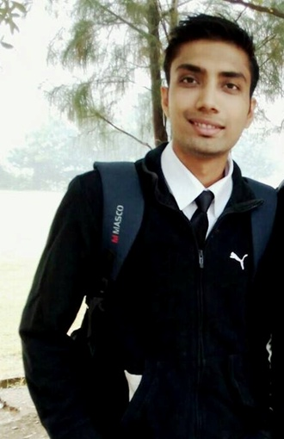
STUDENTS PLACEMENTS OF EE DEPT
TCS
TCS
TCS
HINDUJA GROUP
NPTI
TCS
TECH MAHINDRA

Slide 21
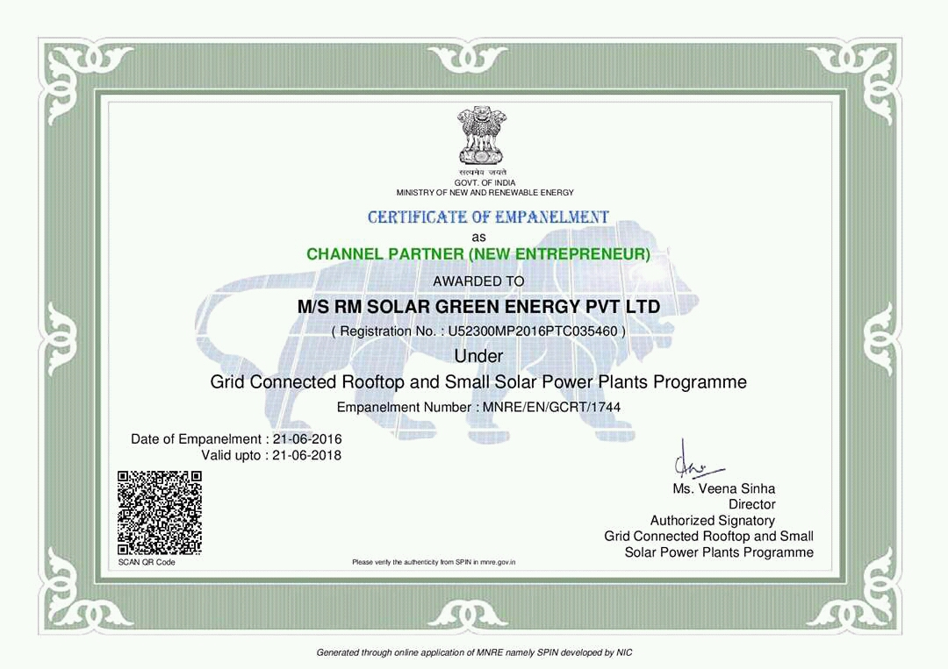
START-UP BY STUDENTS OF EE DEPT.

Slide 22
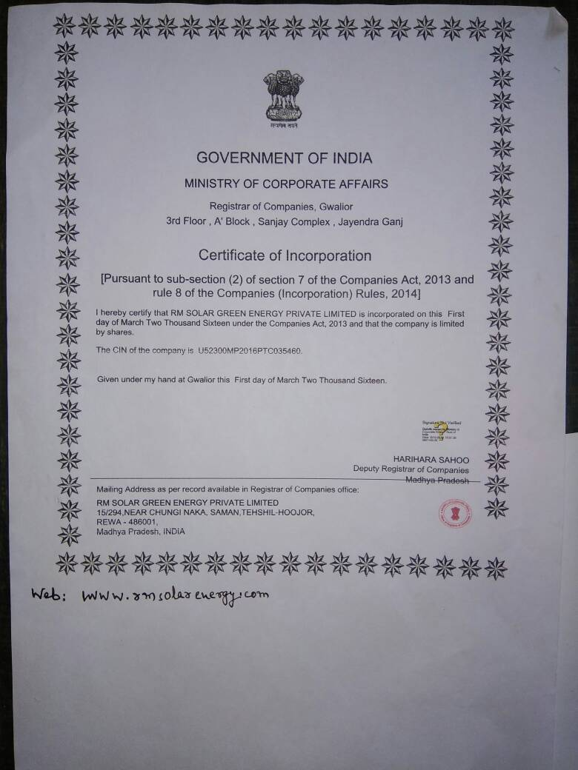
START-UP BY STUDENTS OF EE DEPT.

Slide 23
State of Art Laboratories
SR. NO. | Laboratories
1 | BASIC ELECTRICAL & ELECTRONICS ENGG
2 | NETWORK LAB
3 | ELECTRICAL INSTRUMENTATION & MESUREMENT LAB
4 | ANALOG ELECTRONICS LAB
5 | JAVA PROG. LAB
6 | ELECTRICAL MACHINE-1 LAB
7 | CONTROL SYSTEM LAB
8 | DIGITAL ELECTRONICS & DESIGN LAB
9 | POWER SYSTEM LAB
10 | ELECTRONICS INSTRUMENTATION LAB
11 | SWITCH GEAR & PROTECHTION LAB
12 | ELECTRICAL MACHINE -2 LAB
13 | POWER ELECTRONICS LAB
14 | ELECTRICAL DRIVES LAB
`15 | MICROPROCESSOR & MICROCONTROLLER

Slide 24
Laboratories Cont……
SR. NO. | Laboratories
16 | HIGH VOLTAGE TRANSFORMER TESTING LAB
17 | MODELLING & SIMULATION LAB – BASED ON MI-POWER SOFTWARE
18 | MINOR / MAJOR PROJECT LAB
19
20

Slide 25
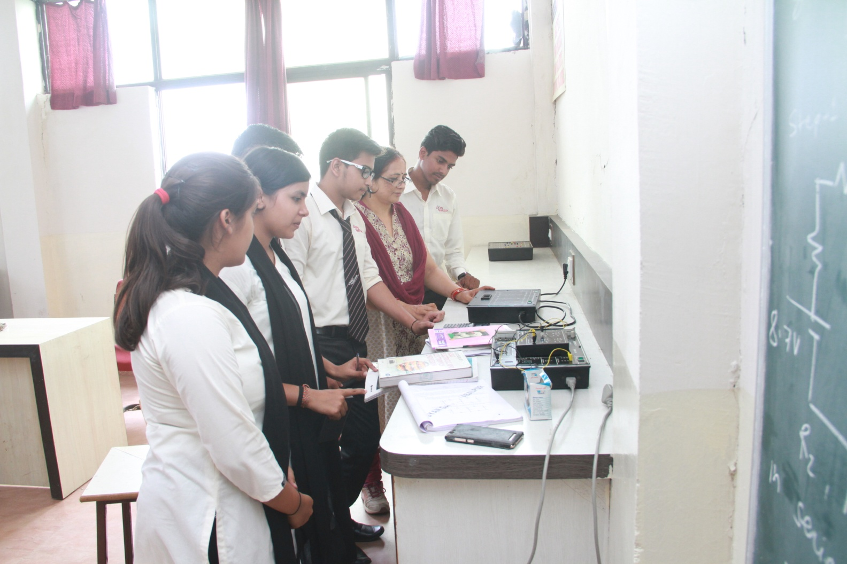
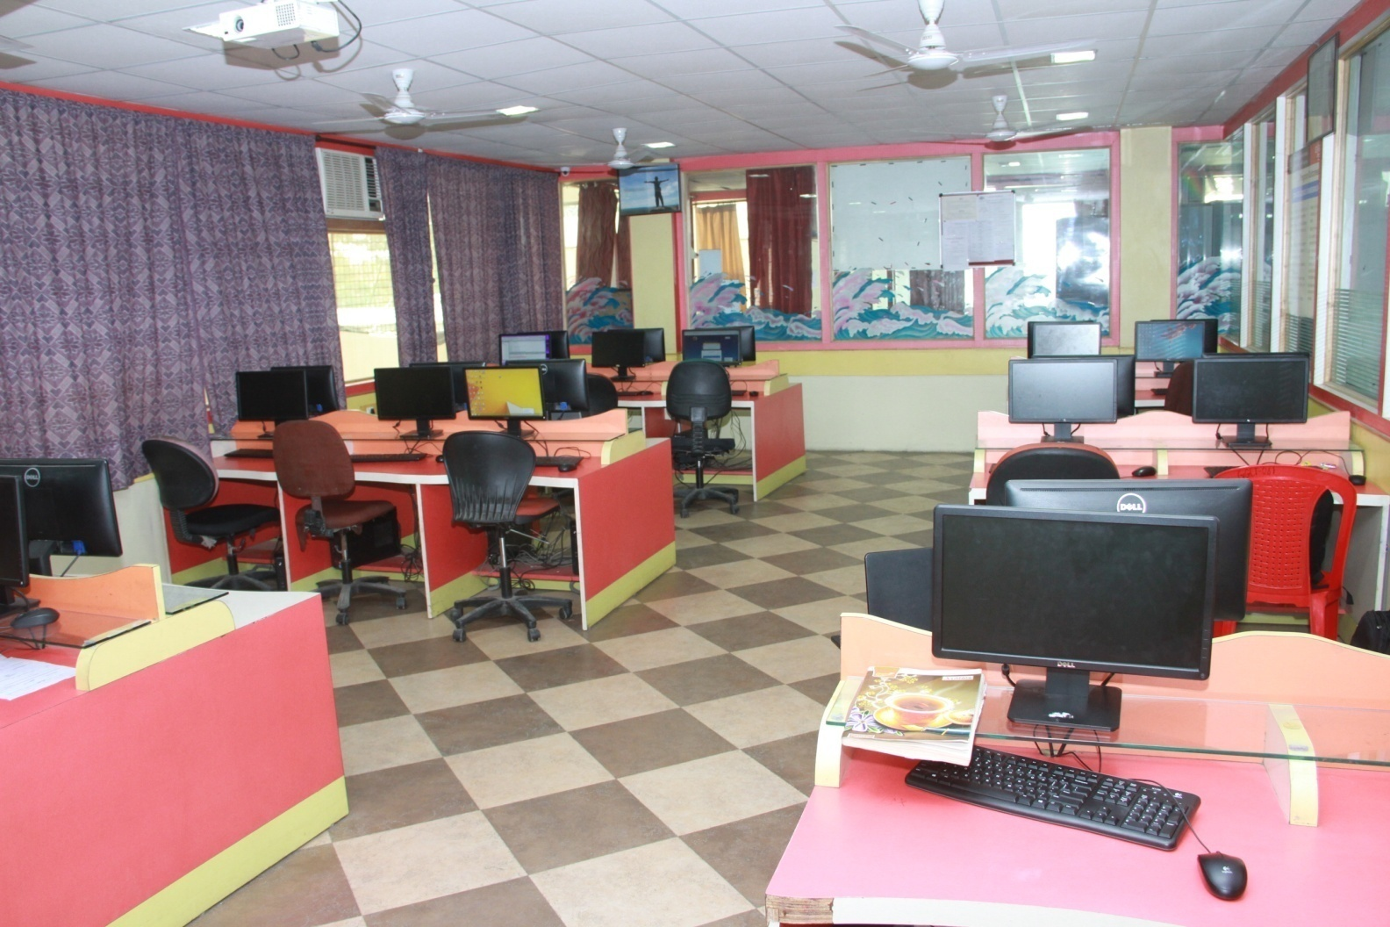
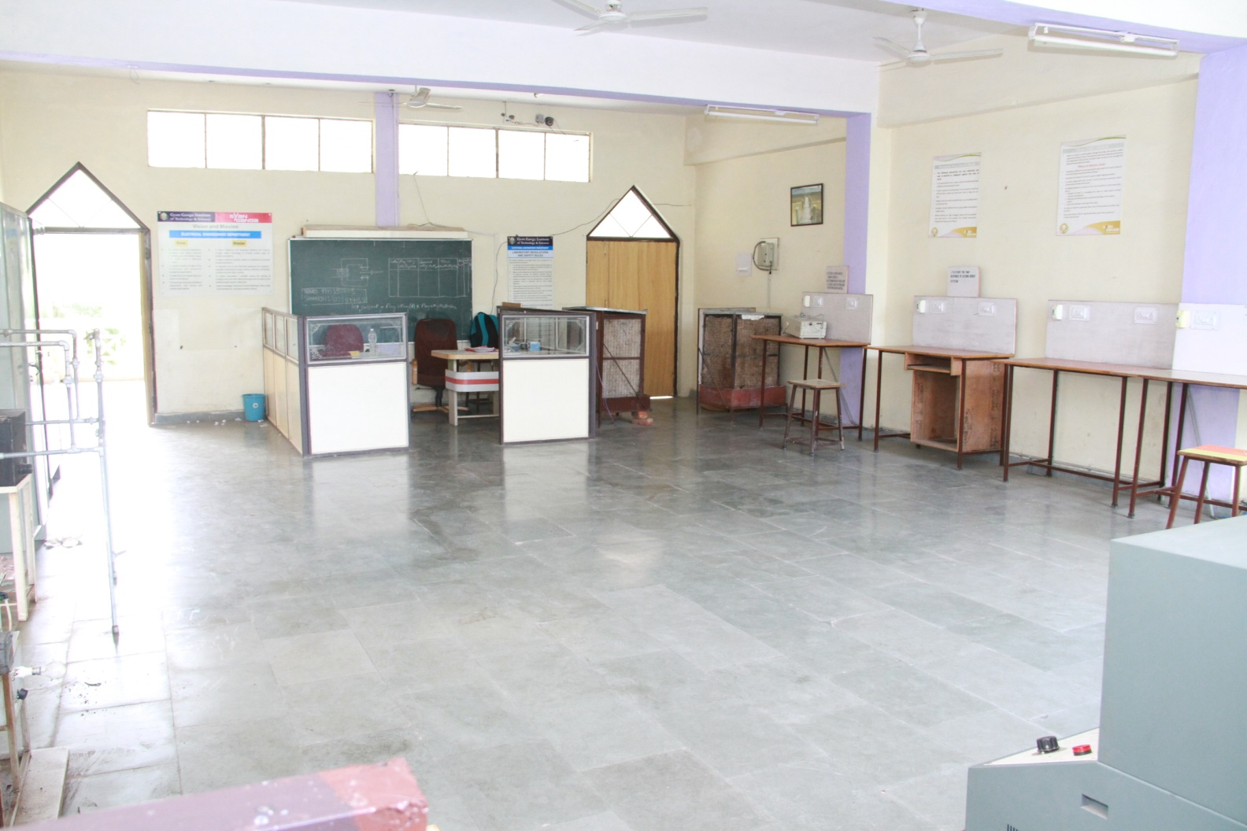
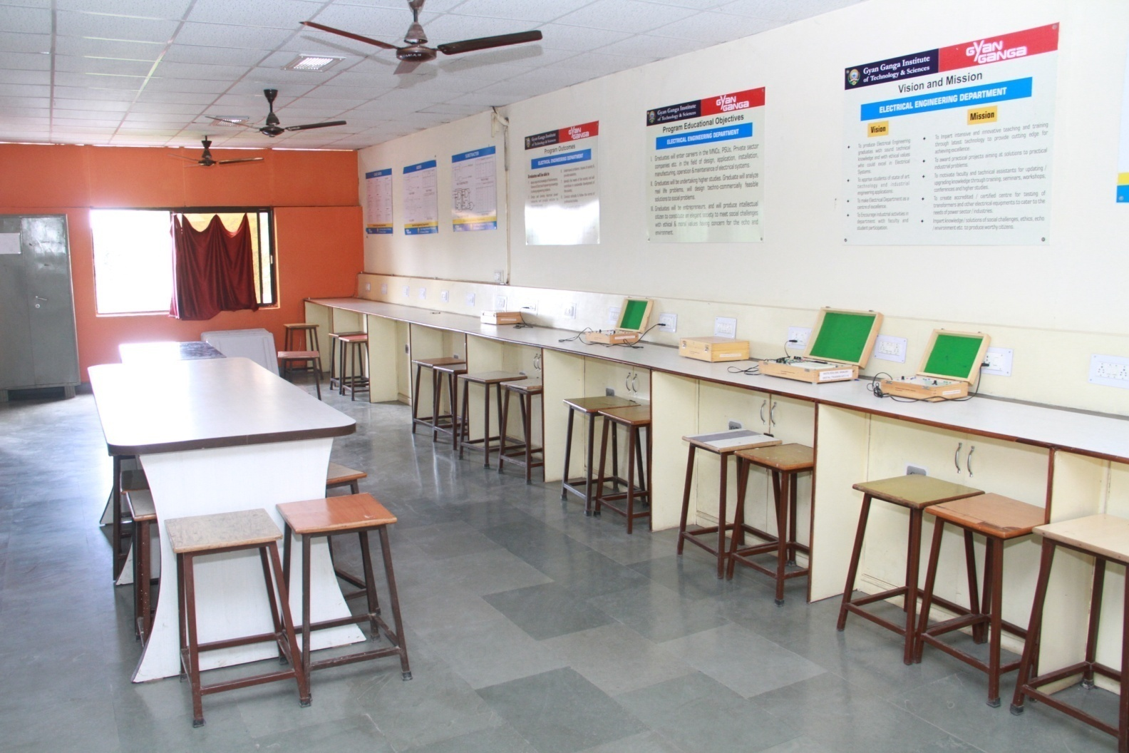
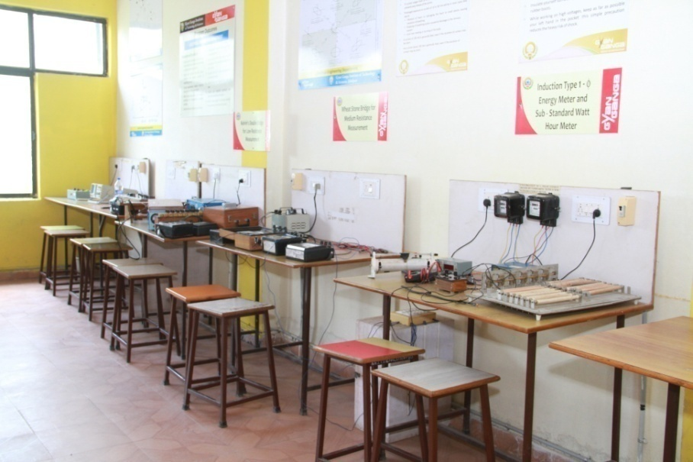
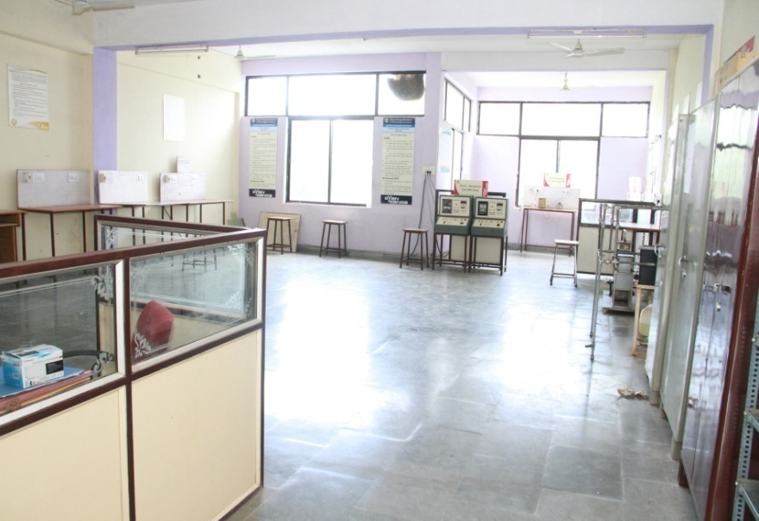
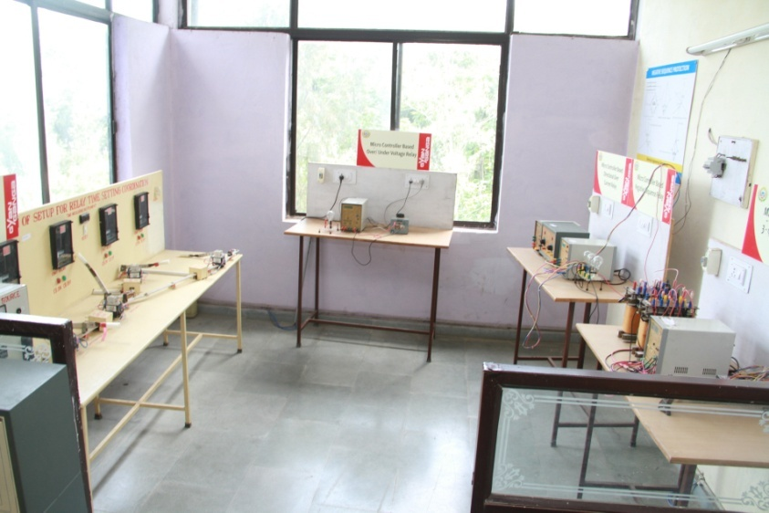
ELECTRICAL INSTRUMENTATION LAB
State of Art Laboratories
CONTROL SYSTEM LAB
POWER SYSTEM PROTECTION LAB

Slide 26

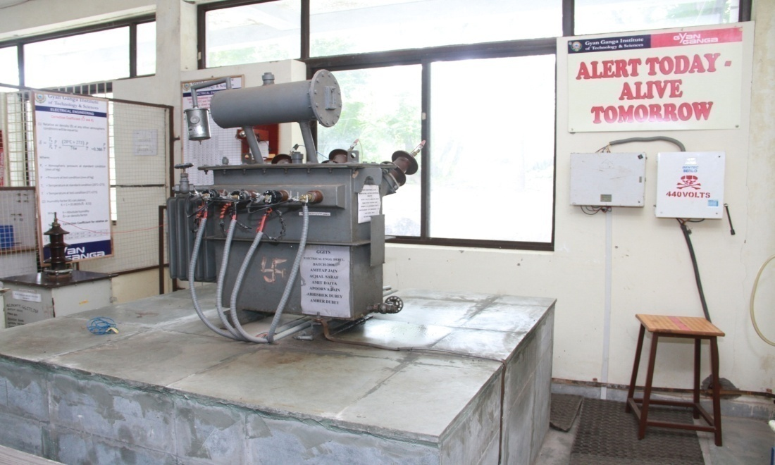
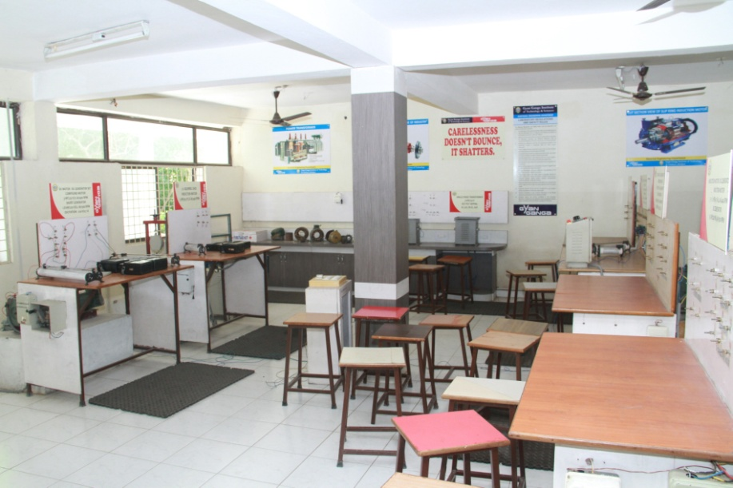
SOFTWARE LAB 1
State of Art Laboratories
HIGH VOLTAGE LAB
ELECTRICAL MACHINE LAB

Slide 27
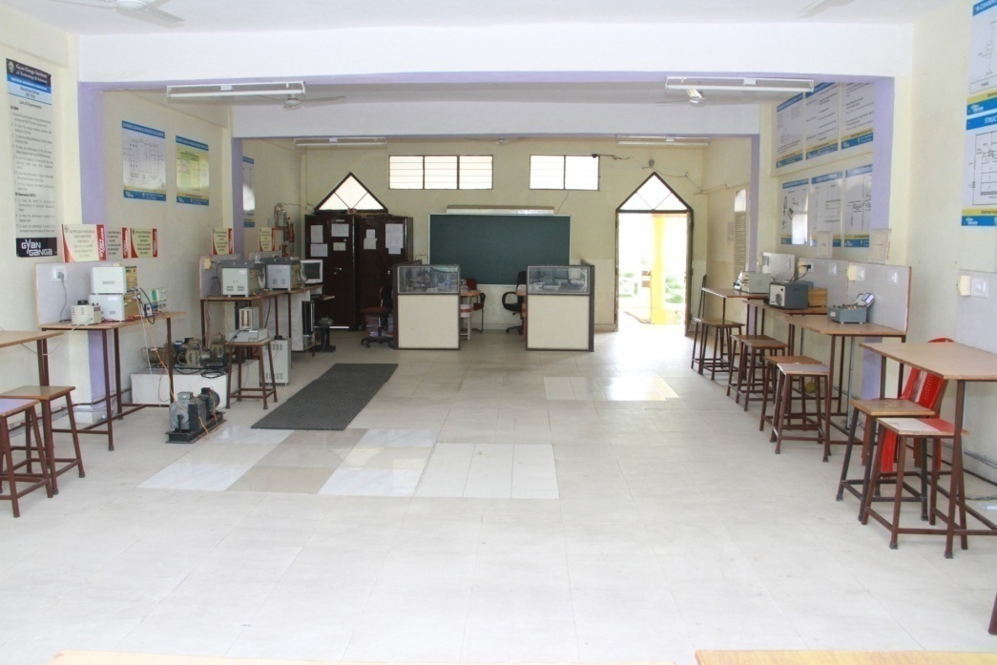
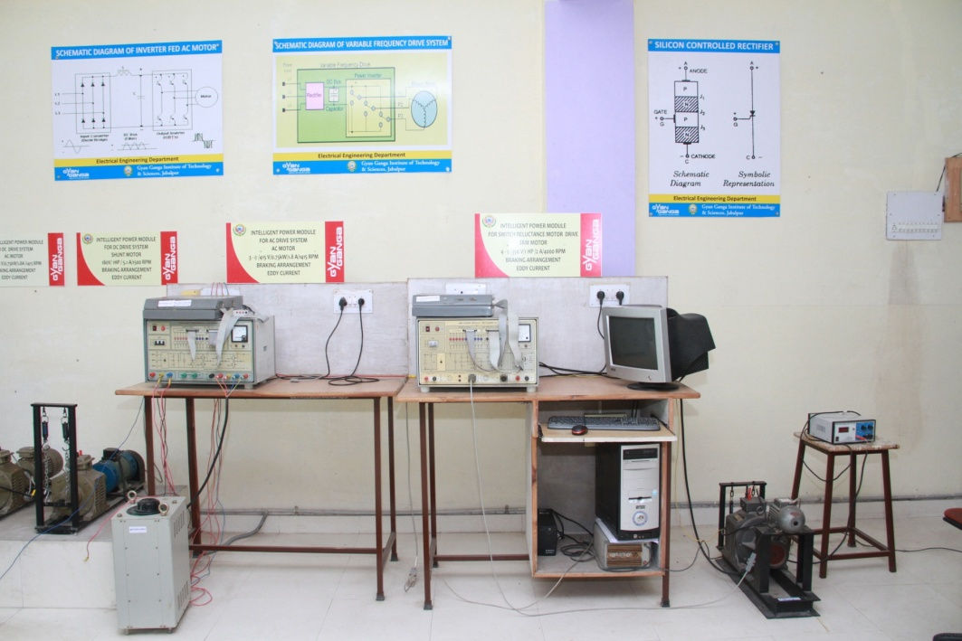
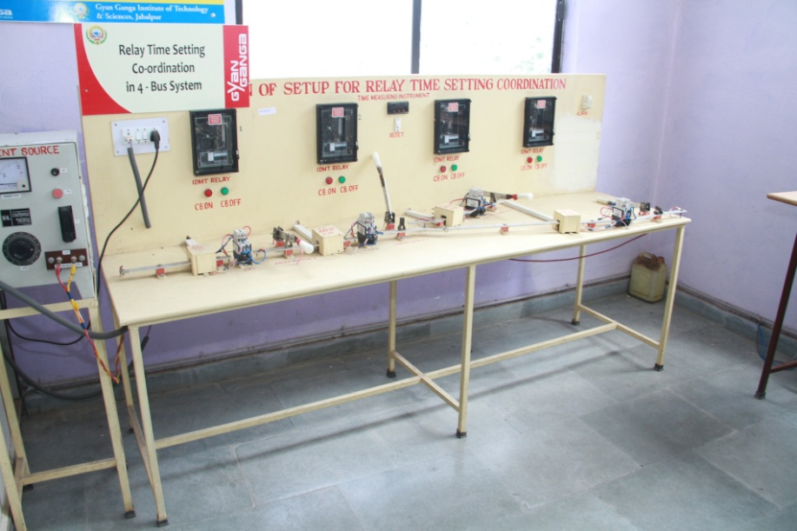
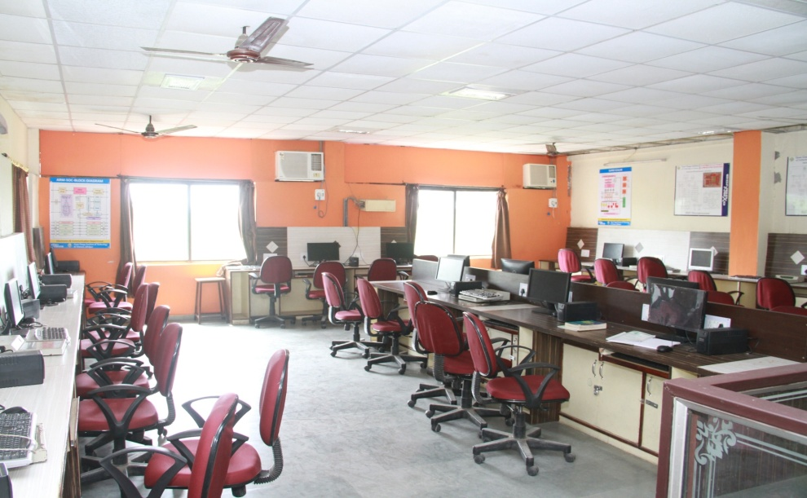
POWER ELECTRONICS LAB
State of Art Laboratories
ELECTRICAL DRIVES LAB
POWER SYSTEM PROTECTION LAB
MICROPROCESSOR & MICRO CONTROLLER LAB

Slide 28
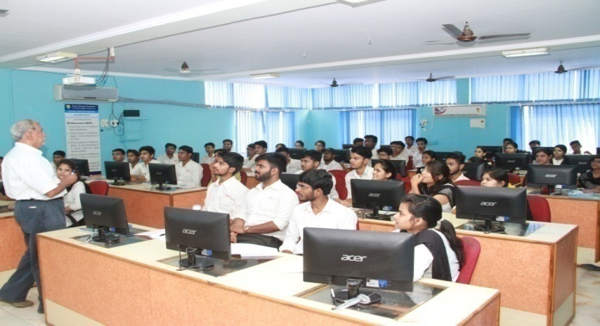

Computer Labs of EE Department
Total availability of the computer systems in the department 60.
All Labs are connected through LAN
The department has a 34 Mbps (BSNL) Leased Line Connectivity for Internet facility.
The entire Department is Wi-Fi enabled.
All the systems have UPS and supported with a power backup by Generator.
Student PC Ratio : 1 : 1
Extent of usage : 100%
Opening Time : 09: 30 A.M.
Closing Time : 07: 00 P.M.

Slide 29
ICT Infrastructure in Dept.
EQUIPMENTS | DETAILS | QTY.
Computers Configurations | ACER-INTEL PENTIUM DUAL CORE PROCESSOR @ 3.30 GHZ | 60
 | RAM-4GB, DDR-3,
 | HARD-DISK 500GB
 | MONITOR 18.5”, LCD TFT
Projectors installed In Class Rooms | Room No. 216, 217 & Software Lab ( IBM), CL-3 Lab, Portable Projector | 05
Scanners & Printers | HP | 03
Computers connected through LAN | The department has a 34 Mbps (BSNL) Leased Line Connectivity for Internet facility. | 60

Slide 30
Dept. Library
Books for various competitive examinations like GATE, UPSC, GRE, TOEFL, CAT, MAT, etc. are also available for students.
Books of Personality Development and General Interests are available in addition to the Books of University curriculum.

Slide 31
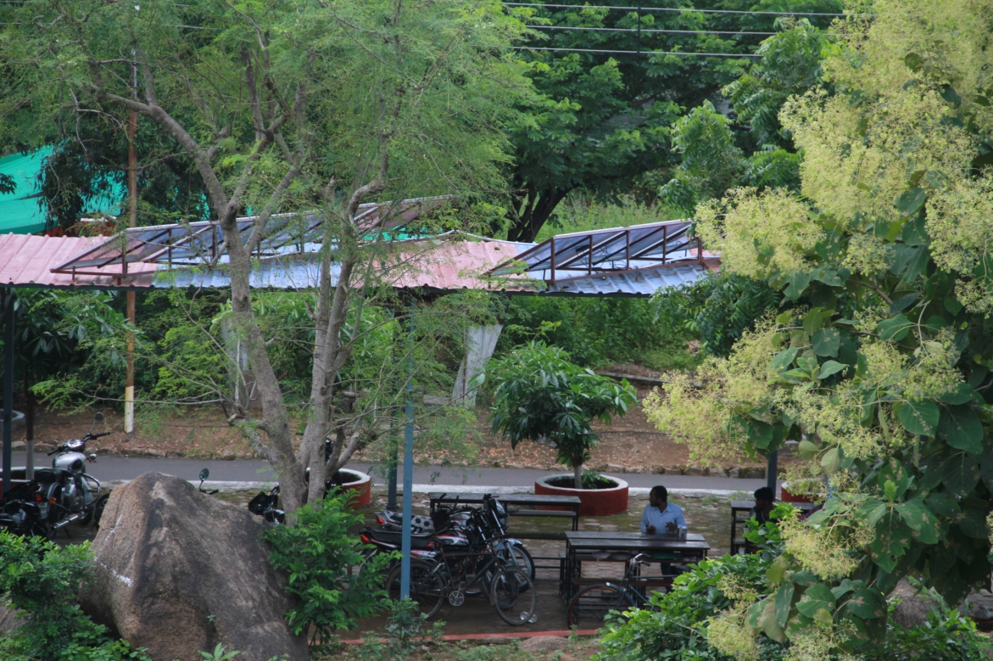
SOLAR PANNEL INSTALLED
Special Projects Designed & Fabricated by EE Ddept.

Slide 32
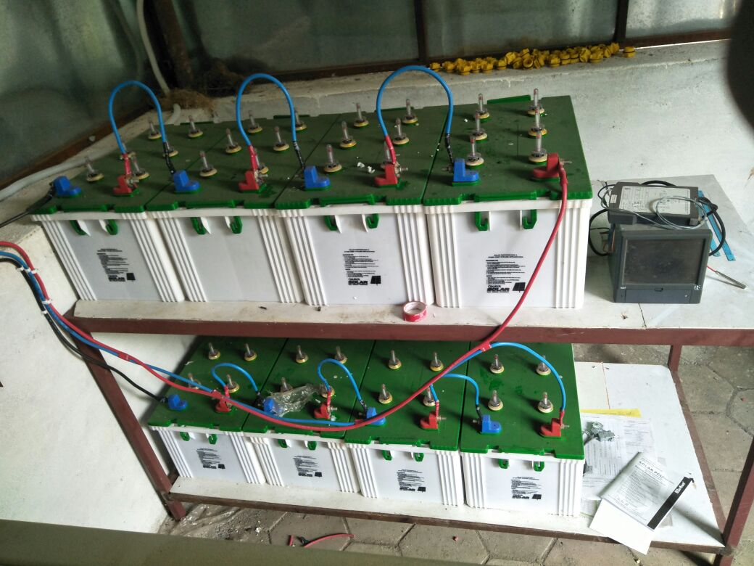
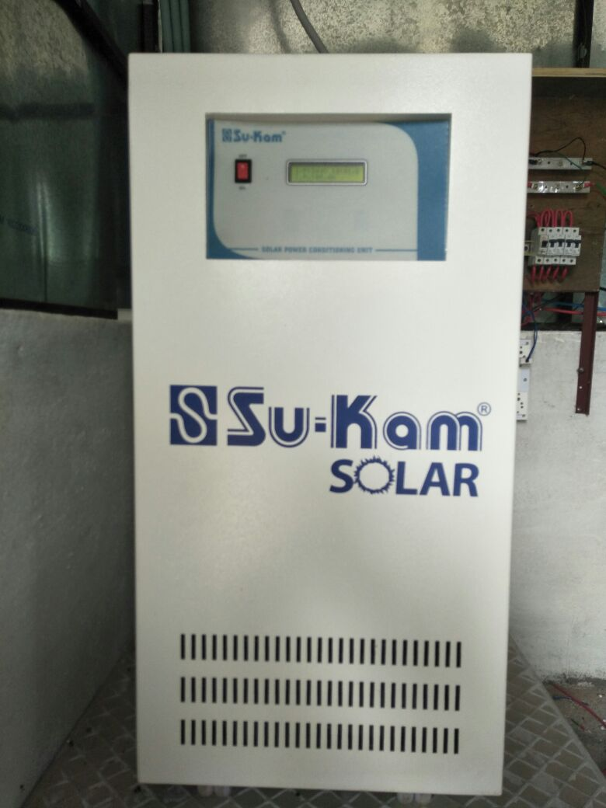
SOLAR PANNEL INSTALLED
Projects Designed & Fabricated by EE Dept.

Slide 33
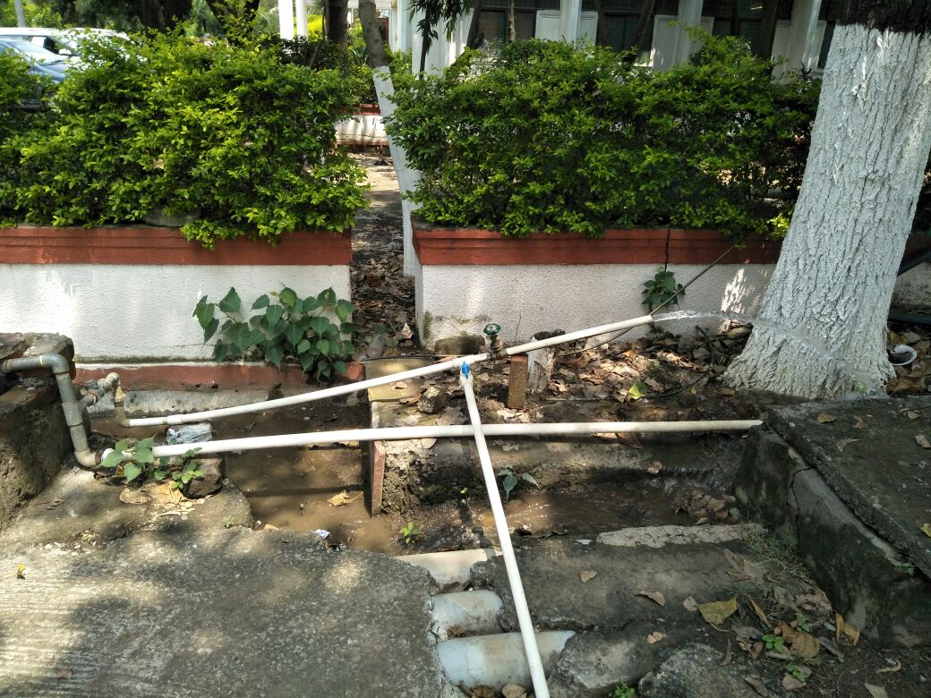
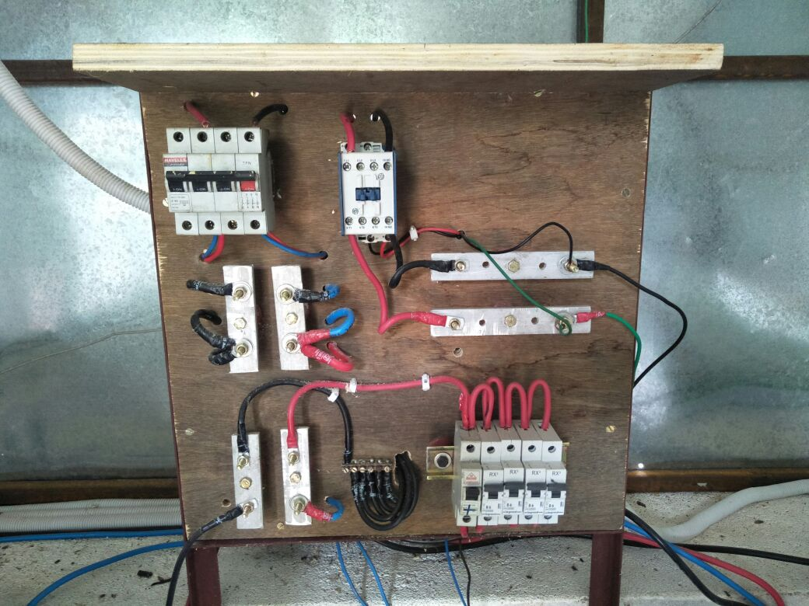
SOLAR PANNEL INSTALLED
Projects Designed & Fabricated by EE Dept.

Slide 34
TESTING of power TRANSFORMERS as per bureau of Indian standard is-2026
(DEVELOPMENT OF
HIGH VOLTAGE LABORATORY)
For
TESTING OF POWER TRANSFORMERS
(AS PER BUREAU OF INDIAN STANDARD IS-2026)
(Designed and Fabricated Major Projects by the Students of Electrical Engg. )

Slide 35
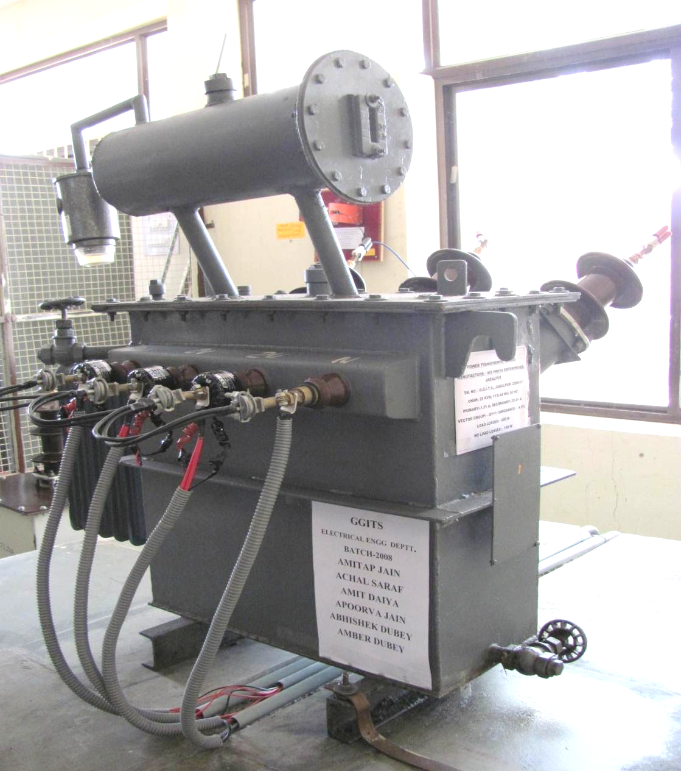
TRANSFORMER
UNDER
TEST
IN
LAB

Slide 36
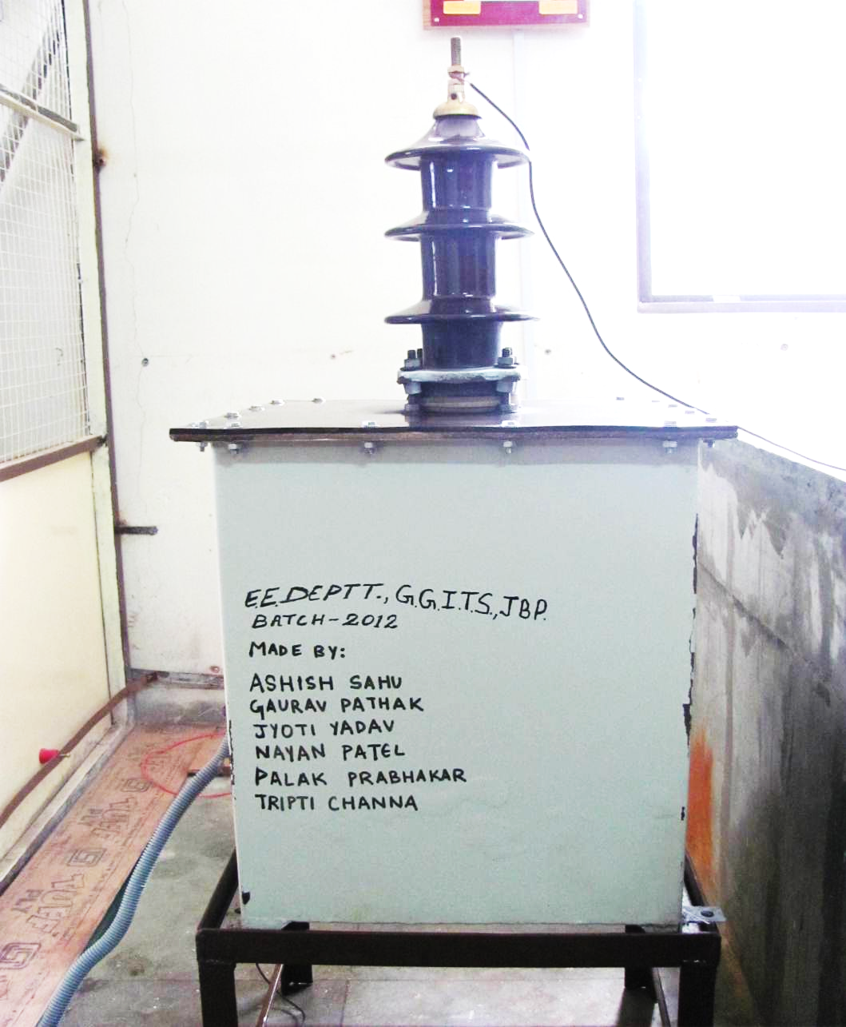
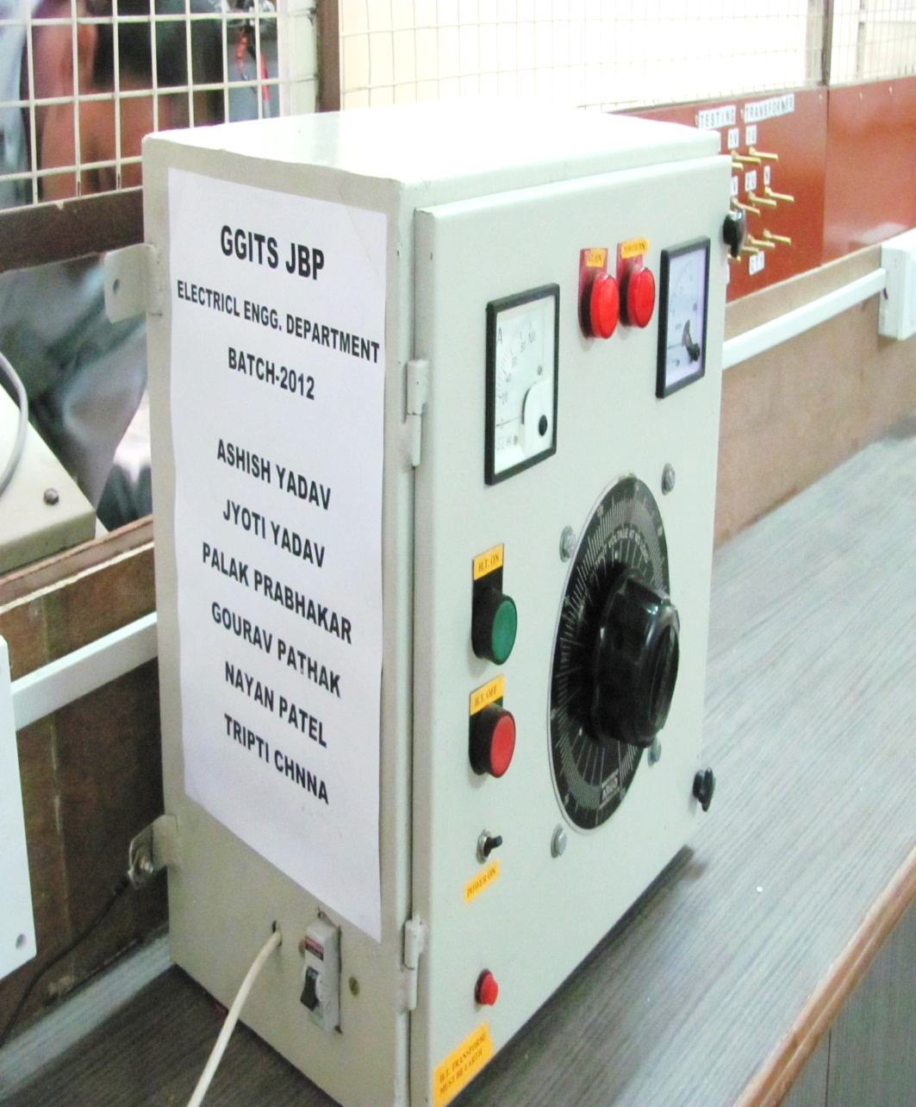
28 KV SEPARATE VOLTAGE SOURCE WITH STANDARD TEST EQUIPMENTS

Slide 37
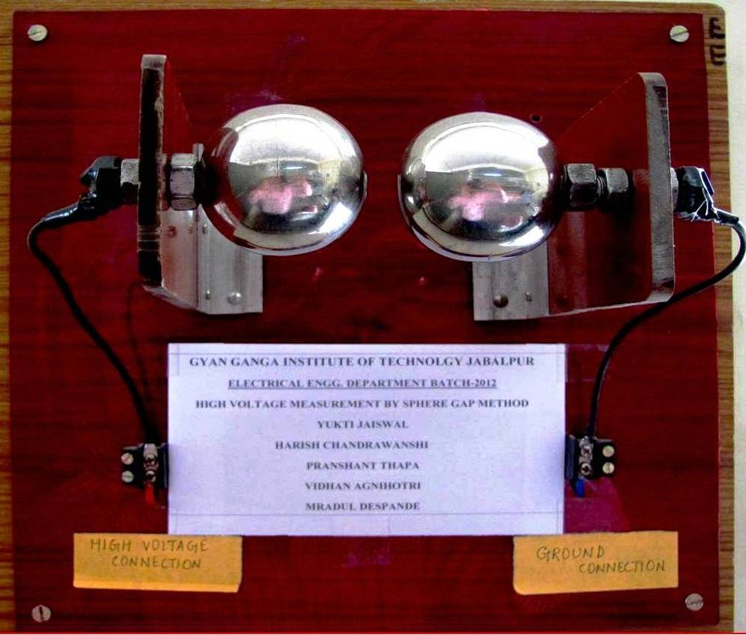
VOLTMETER TO MEASURE HIGH VOLTAGE

Slide 38

DOUBLE
VOLTAGE
DOUBLE
FREQUENCY
TEST
SETUP

Slide 39

DOUBLE
VOLTAGE
DOUBLE
FREQUENCY
TEST
SETUP

Slide 40

TRANSFORMER OIL
BREAK
DOWN
VOLTAGE
TEST
SETUP

Slide 41


. VOLTAGE BOOSTER FOR LOAD LOSSES TEST AND % IMPEDANCE MEASUREMENT

Slide 42

HIGH VOLTAGE LABORATORY ELECTRICAL ENGG. DEPARTMENT GYAN GANGA INSTITITUTE OF TECHNOLOGY , JABALPUR

Slide 43


SOLAR PANNEL INSTALLED
Projects under taken By EE Dept.
250KW GRID CONNECTED SOLAR PV ROOFTOP SYSTEM

Slide 44
CONSULTANCY DETAILS
(a) % of pass in First Class : Discipline wise
( Figures in percentage )
SR. NO. | NAME OF THE COMPANIES | NAME OF THE CONSULTANCY PROJECT
1 | PRAGYA ENTERPRISES , JABALPUR | DESIGN AND DEVELOPMENT OF 30 kV SEPARATE VOLTAGE SOURCE WITH CONTROL UNIT
2 | SYSTEM ELECTRONICS LABORATORY (SEL) JABALPUR | DESIGN AND DEVELOPMENT OVER VOLTAGE AND UNDER VOLTGE PROTECTION
3 | UNIVERSAL MAGNO FLUX LTD. INDORE | DESIGN AND DEVELOPMENT OF 11 KV CURRENT TRANSFORMER
4 | PRAGYA ENERGY PRIVATE LTD. JABALPUR | EVALUATION OF THE CALORIFIC VALUE OF THE FUEL

Slide 45
CONSULTANCY DETAILS
(a) % of pass in First Class : Discipline wise
( Figures in percentage )
SR. NO. | NAME OF THE COMPANIES | NAME OF THE CONSULTANCY PROJECT
5 | GAYN GANGA INTERNATIONAL SCHOOL, JABALPUR | DESIGN AND DEVELOPMENT OF THE BIO GAS PLANT
6 | PRDC, BANGLORE | CONSULTANCY SERVICES FOR POWER SYSTEM ANALYSIS, POWER EVACUATION STUDIES, NETWORK SIMULATION AND DESIGN, MASTER PLAN PREPARATION FOR T&D INFRASTRUCTURE & GRID CONNECTIVITY
7 | R M SOLAR GREEN PVT. LTD | RESEARCH AND DEVELOPMENT SOLAR SYSTEM EFFICIENCY IMPROVEMENT, SOLAR WATER PUMP, NIGHT LIGHTING SYSM

Slide 46
Technical Training for Students
SEMESTER | TRAINING | OBJECTIVES OF THE TRAININGS
3rd Sem. | FUNDAMENTALS PROGRAMMING OF THE C & C++ | IN HOUSE TRAINING ON PROGAMMING SKILLS FOR ENHANCEMENTS HELPS IN CAMPUS PLACEMENTS , PROJECTS WORKS
4th Sem. | POWER SYSTEM AND ITS ELEMENTS FOR DISTRIBUTION OF POWER | IN HOUSE TRAINING ON THE BASICS OF THE POWER SYSTEM AND ITS VARIOUS ELEMENTS USED IN DISTRIBUTION SYSTEM
5th Sem. | MATLAB AND ITS APPLICATIONS IN ELECTRICAL ENGG | IN HOUSE TRAINING ON THE MATLAB COMPUTATIONAL SOFTWARE FOR VARIOUS APPLICATION IN POWER SYSTEM , ELECTRICAL MACHINES ETC

Slide 47
Technical Training for Students
Semester | Training | OBJECTIVES OF THE TRAININGS
5th Sem. & 6th Sem. | PLC | OUT SOURCED TRAINING FOR UNDERSTANDING OF PROGRAMABLE LOGIC CONTROLLERS FOR INDUSTRIAL AUTOMATION
6th Sem | SCADA | OUTSOURCED TRAINING FOR UNDERSTANDING OF SUPERVISIORY CONTROL AND DATA AQUISTION FOR POWER SYSTEM
7th Sem | HMI | OUTSOURCED TRAING FOR UNDERSTANDING OF HUMAN MACHINE INTERFACE LIKE ROBOTICS APPLICATIONS , MACHINES AUTOMATIONS
7th Sem | MI-POWER | POWER SYSTEM ANALYSIS, POWER EVACUATION STUDIES, NETWORK SIMULATION AND DESIGN, MASTER PLAN PREPARATION FOR T&D INFRASTRUCTURE, GRID CONNECTIVITY STUDIES,INTEGRATION OF HYBRID SYSTEMS ALTERNATE SOURCES

Slide 48
Soft skills Training for Students
Semester | Training
1st Sem. | Comm. Skills
2nd Sem. | Comm. Skills & Personality Development
3rd Sem. | Group Discussions & Personality Development
4th Sem. | Career Skills Program
5th Sem. | Enhancing Recruitment Skills of Students
6th Sem. | Campus Training on Soft skills, Group Discussion & Personal Interview

Slide 49

Qualification and Experience of Faculty Members
Qualification | No. of Faculty Members
Ph.D. | -
Ph.D. (P) | 03
M. Tech./PG | 15
TOTAL | 18
Industry Experience | No. of Faculty Members
More than 30 years | 01
05-10 years | 01
Teaching Experience | No. of Faculty Members
More than 20 years | 01
10-20 years | 04
5-10 years | 13
TOTAL | 18
Overall Faculty Student Ratio is 1:14

Slide 50


BOOKS PUBLISHED BY THE FACULTY OF EE DEPT
FOR GATE EXAMINATION
PROF. VIVEK ANANAD, IN 2016 & 2017

Slide 51
Teaching Learning Process: Beyond Syllabus
Centre For Distance Engineering Education Programme, IIT , BOMBAY
Objective :
Engineering and Science students in every part of India and the world will have access to IIT Bombay's courseware.
SIGNALS & SYSTEM
FACULTY MEMEBRS & STUDENTS REGISTERED FORM EE DEPT.: 60 ( BE- V SEMESTER, IN 2016V)

Slide 52
NPTEL (national programme on technology enhanced learning) is a joint initiative of the iits and iisc. Through this initiative, we offer online courses and certification in various topics.
Teaching Learning Process: Beyond Syllabus
Prof. Nagendra Krishnapura,
Department of Electrical Engineering
IIT Madras
Course duration : July 24, 2017 - September 15, 2017 Full Term - 8 weeks course
Course : Basic Electrical Circuit
STUDENTS REGISTERED : 15 ( BE- FIRST SEMESTER) ON LINE EXAMINATION : 24TH SEPTEMBER , 2017

Slide 53
Sponsorship for Higher Studies for Faculty Members
Facilitation done by the college for the teachers to do higher educational program like Ph.D. or PG program : (From last Accreditation)
S. No. | Department | Numbers admitted in Ph.D. | Numbers admitted in M.E.
1. | Electrical Engineering | 03 | 11
 | TOTAL | 03 | 11

Slide 54
Sponsorship for Higher Studies Technical Staff
Facilitation done by the college for the Technical Assistant to do higher educational program like DIPLOMA, UG. or PG program :
S. No. | Branch | Numbers admitted in DIPLOMA | Numbers admitted in BE | Numbers admitted in ME
1. | Electrical Engineering | 03 | 01 | -
 | TOTAL | 03 | 01 | -

Slide 55
Sponsorship for Seminars /Conferences/Workshops
No. of Faculty have been sponsored in the Last 3 years for attending National Conference, International Conferences, Workshops etc. :
S. No. | Department | Conferences (Nat./Int. Nat.) | Seminars | Workshops, etc.
1. | Electrical Engineering | 20 | 25 | 20

Slide 56
Major Software
S. No. | Department | Licensed Software Available in Dept.
1. | Electrical Engineering Dept. | Mi Power MATLAB Design Builder

Slide 57
Faculty Membership
The International Association of Engineers (IAENG), USA
IEEE (Institution of Electrical & Electronics Engineers)
ISTE (The Indian Society for Technical Education)
IEI (Institution of Engineers India)
SESI (Solar Energy Society of India)
SPE (Society of Power Engineers , India)

Slide 58


MOUs With Industries
MOU UNIVERSAL MAGNO FLUX LTD. INDORE
PRAGYA ENTERPRISES
MOU PRAGYA ENTERPRISES , JABALPUR .
MOU WITH SOFCON INDIA (P) LTD., NOIDA FOR TRAINING OF ELECTRICAL ENGG. STUDENTS ON PLC SCADA (UNDER PROCESS).
MOU SYSTEM ELECTRONICS LABORATORY (SEL) JABALPUR
SYSTEMS ELECTRONICS LABORATORY

Slide 59



MOUs With Industries
PRAGYA ENERGY PRIVATE LTD. JABALPUR
MOU PRAGYA ENERGY PRIVATE LTD. JABALPUR
MOU GAYN GANGA INTERNATIONAL SCHOOL, JABALPUR
MOU PRDC, BANGLORE
MOU SYSTEM ELECTRONICS LABORATORY (SEL) JABALPUR

Slide 60



Associations, Training Partners
Training Partnership with CTI, JABALPUR
Training Partnership with MPPTCL, JABALPUR
Training Partnership with SOFCON, NOIDA
Training Partnership with BSNL

Slide 61
Faculty Development Program
S.No. | Programme | TITLE | Remarks
1 | Staff Development Programme | MATLAB TRAINING PROGRAM FOR FACULTY ENRICHMENT AND SELF IMPROVEMENT | Organized in collaboration with IIITDM JABALPUR
2 | Entrepreneurship Development Programme | TO DEVELOP BUSINESS VENTURE | Organized by Entrepreneurship Development Cell , GGITS
3 | Workshop By Wipro (Mission 10X) | CREATIVE TEACHING AND EFFECTIVE CLASS ROOM MANAGEMENT | Organized
4 | Staff Development Programme | TRAINING ON MI-POWER SOFTWARE | In house organized
5 | National Seminar (AICTE SPONSORED ) | POWER SYSTEM EARTING /GROUNDING | Under Process Proposed Date DEC. 2017

Slide 62
Technical staff Development Program
S.No. | Programme | Title | Remarks
1. | Technical Staff Development Programmer | Testing of Power Transformer as per IS -2026 Codes | Organized
2. | Training on Maintenance & Installation of Electrical Machines | Maintenance of AC & DC Electrical Machines | Organized
3. | Training on installation of off grid solar panel installation | Installation , Metering & of the Roof Top Solar panel | Organized

Slide 63
Research & Development Proposals- Submitted to AICTE under
(AICTE Quality Improvement Schemes) (AQIS) in 2017
S.NO. | PROGRAMME | TITLE | BUDGET | REMARKS
1. | NATIONAL SEMINAR /WORKSHOP | POWER SYSTEM EARTHING / GROUNDING | 2.0 LAKHS | UNDER PROCESS PROPOSED DATE DEC. 2017, (SPONSORED BY AICTE) 50% GRANT RECEIVED
2. | FDP | POWER SYSTEM PLANNING AND STUDIES | 7.0LAKHS | SUBMITTED TO AICTE
3. | NATIONAL SEMINAR | ADVANCEMENTS IN ELECTRICAL POWER SYSTEM: QUALITY, RELIABILITY, LOSSES & METERING | 2.0 LAKHS | SUBMITTED TO AICTE
4. | MOROBS | MODERNISATION OF POWER SYSTEM LAB | 21.5 LAKHS | SUBMITTED TO AICTE

Slide 64

BEST TEACHER AWARDS- 2016, 2017
PROF. S K BAJPAI , PROF. NIDHI MISHRA , PROF. SHIRISH JAIN,
PROF, POONAM SARWGI,
PROG. RAGHUWANSH SINGH

Slide 65




ENTREPRENEUR DEVELOPMENT WORKSHOP

Slide 66
Professional Societies of Students
Solar Energy Society of India (SESI)
CSI Student Chapter
IEEE Student Chapter
Notes:
66

Slide 67
Industrial Training Partners
S G T P S Birsinghpur Pali
C T I Jabalpur
B H E L Bhopal
M P P T C L Jabalpur
W C R Jabalpur
Hydro Power Plant Bargi Jabalpur
S S T P P Khandwa M.P.
G C F Jabalpur
DSPN TPS Korba
Ordinance Factory Katni M.P.
Vehicle Factory Jabalpur
Ordinance Factory Khamariya M.P.
Diesel Loco Shed, Katni
MTRU Jabalpur
Power Grid Jabalpur
NTPC, Birsinghpur
NTPC, Singrauli
Ordnance Factory, Khamaria, Jabalpur

Slide 68
Co-CURRICULAR ACTIVITIES ORGANISIED BY THE DEPARTMENT

Slide 69


REPUBLIC DAY CONTINGENT CAMP
HARSHILA SURI (2014 Batch )

Slide 70


Slide 71

INDUSTRIAL VISIT

Slide 72


Slide 73
Extra-curricular Activities
The students run many Hobby clubs like :
Photography club
Music club
Technical club
Language club
Fine Arts club
Programming club

Slide 74
Social Activities
The students participate in the following through Rural Outreach Program/NSS :
Tree Plantation
Blood Donation
Awareness on Education to Rural People

Slide 75

Social Activities
Awareness on Education to Rural People

Slide 76

Green Energy Based Projects: Off Grid Solar Rooftop Generation

Slide 77
STUDENTS PARTICIPATION IN ACTIVITIES IN REPUTED INSTITUTE
Sameer Garhawal and Team of fourth semester Electrical Engineering students had participated and secured 6th all INDIA rank in GREENX event organized by IIT –BHU.
Team of fourth semester Electrical Engineering students had participated and secured first rank in badminton competition during inter college sports meet held at BITS Goa campus.

Slide 78

STUDENTS PARTICIPATION IN ACTIVITIES IN REPUTED INSTITUTE
Sameer Garhawal and Team of fourth semester Electrical Engineering students had participated and secured 6th all INDIA rank in GREENX event organized by IIT –BHU.
Team of fourth semester Electrical Engineering students had participated and secured first rank in badminton competition during inter college sports meet held at BITS Goa campus.

Slide 79





Participation of the Students in Sports

Slide 80



Cultural Facilities
Interpersonal Skills and Team Work is important and is best achieved by practicing and performing together
An Auditorium named as “SPANDAN” with a sitting capacity of approx. 600.
Institute also has an “Open Air Theater” for Annual Cultural events and Fests. We can entertain a crowd of more than approx. 5000 people.

Slide 81


Slide 82


Slide 83

Expert Lectures:
MR. ANSHUL OJHA, Senior Consultant, Accenture Australia has delivered an expert lecture on “Scope of Higher Education in abroad and Opportunities in the IT world”. For sixth semester students of Electrical engineering department.

Slide 84
TESTING of power TRANSFORMERS as per bureau of Indian standard is-2026
(DEVELOPMENT OF
HIGH VOLTAGE LABORATORY)
For
TESTING OF POWER TRANSFORMERS
(AS PER BUREAU OF INDIAN STANDARD IS-2026)
(Designed and Fabricated Major Projects by the Students of Electrical Engg. )

Slide 85
TRANSFORMER
UNDER
TEST
IN
LAB

Slide 86
28 KV SEPARATE VOLTAGE SOURCE WITH STANDARD TEST EQUIPMENTS

Slide 87
VOLTMETER TO MEASURE HIGH VOLTAGE

Slide 88
DOUBLE
VOLTAGE
DOUBLE
FREQUENCY
TEST
SETUP

Slide 89
DOUBLE
VOLTAGE
DOUBLE
FREQUENCY
TEST
SETUP

Slide 90
TRANSFORMER OIL
BREAK
DOWN
VOLTAGE
TEST
SETUP

Slide 91
. VOLTAGE BOOSTER FOR LOAD LOSSES TEST AND % IMPEDANCE MEASUREMENT

Slide 92
HIGH VOLTAGE LABORATORY ELECTRICAL ENGG. DEPARTMENT GYAN GANGA INSTITITUTE OF TECHNOLOGY , JABALPUR

Slide 93

TIMER & RELAY
BASED CONTROL
CIRCUIT FOR THE
DIFFERENT
SETUPS
TO CONDUCT
THE
SUITABLE
HIGH VOLTAGE
TESTING
ON TRANSFORMERS

Slide 94

PROTECTION
SETUP
FOR ANY
HARZADS
DURING THE
HIGH VOLTAGE
TESTING

Slide 95
Alumni of Electrical Engg. Dept. GGITS

Slide 96

Parul Sardana (Batch-2007)
Profile
Cognizant
Senior Associate :-2014 to present, Pune, India
E-Clerx
Senior Financial Analyst :-2010 to 2014, Pune, India

Slide 97

Sheetal Pandey (2007)
Profile
Reliance Industries Limited
Manager : October 27, 2007 to present

Slide 98

Kanchan Bose (2008)
Profile
Korea Electric Power Corporation
Sr. Engineer – Projects (2012 –till present)
Collabera Inc
Saint Louis, Missouri
Bank of America

Slide 99

Amit Dahiya (2008)
Senior Engineer,
MPPTCL, Jabalpur
2010 – till present)

Slide 100

Swantantra Kasera (2008)
Work
Nepa Limited
Assitant Mananger Electrical · September 1, 2015 to present · Nepanagar
Monnet Ispat & Energy Ltd.
Engineer · October 19, 2009 to May 1, 2010

Slide 101

Hitesh Daryani (2009)
Works
Software Engineer at
Mphasis (A Sister Concern HP Company
Lives in Bangalore, India

Slide 102

Kriti Verma (2010)
Profile
Wipro
Project Engineer · March 2011 to present · Bangalore, India
SUVIDHA ENGG. INDIA PVT LMTD ( MUMBAI)
GET · July 2010 to January 2011 · Mumbai, India

Slide 103

Aditya Banerjee (2011)
Essar Group
Deputy Manager :July 2011 to present ,Jamnagar

Slide 104

Akshay Dubey (2011)
Work
Cognizant Technology Solutions
July 2014 to present · Pune, India
Senior Systems Executive
Tata Consultancy Services
Asst.System Engineer · March 2012 to 2014

Slide 105

Suvit Rathore (2011)
profile
Tata Consultancy Services
Gurgaon, Haryana

Slide 106

Palak Prabhakar (2012)
Work Profile
Tata Consultancy Services
System Engineer ·
March 18, 2013 to present · Hyderabad, India

Slide 107

Raj Bhatia (2012)
Works at Deloitte Consulting US-India Pvt. Ltd.
Past: Tata Consultancy Services
Studied at ggits
Lives in Mumbai, India

Slide 108
Akshay Chouksey (2013)
Work
Robert Bosch LLC - Research and Technology Center.
Analyst, Mobile App Integration · Palo Alto, California
Education
School of Information Studies at Syracuse University
Information Management · Syracuse, New York

Slide 109

Shalu Chanwani (2014)
TCS Neptune
June 2015 to present
Tata Consultancy Services
Assistant System Engineer-T · Trivandrum, India

Slide 110
Siddharth Ahuja (2015)
GRE Score :-324 (2015)
University of Illinois , Urbana Champaign USA
(World Ranking Top 21 University-2015)
Specialization Technology Management

Slide 111
Thank You

